Slide 1
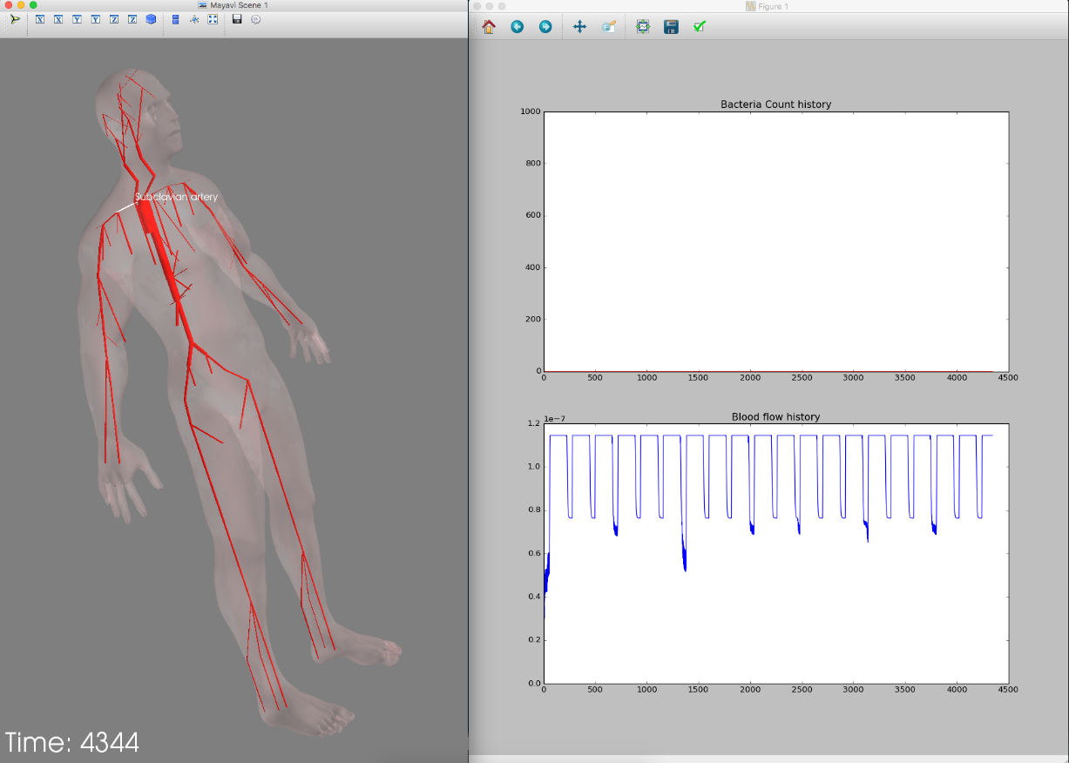
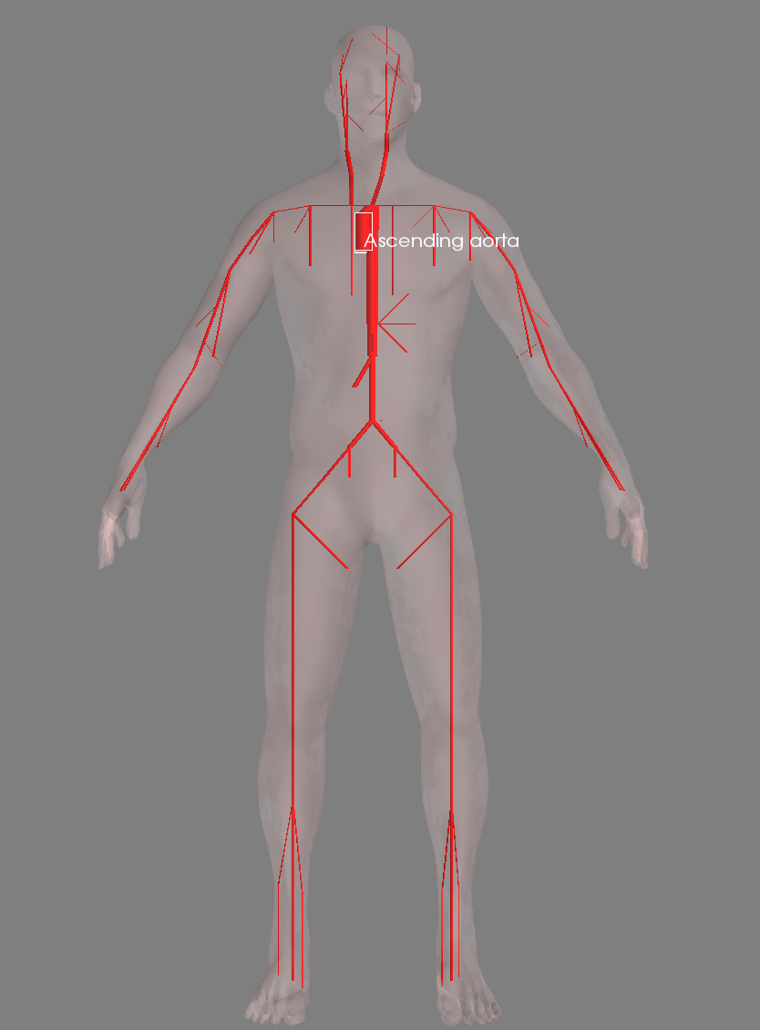
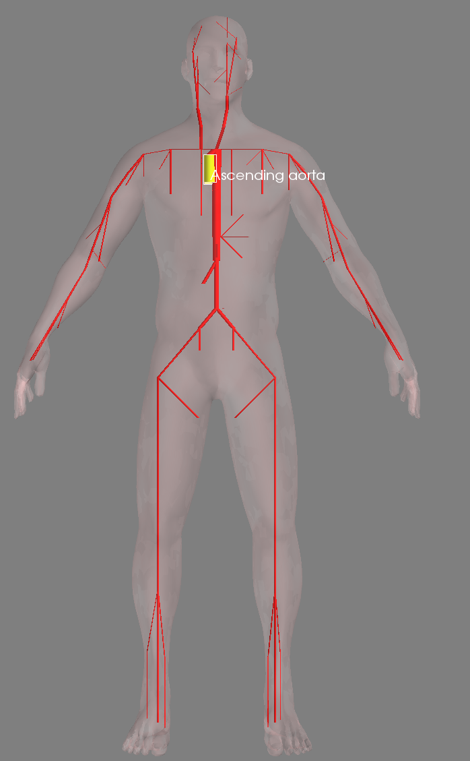
Generic Bacteria Simulation on Human Body
Enmao Diao, Haoli Du
Georgia Institute of Technology
OBJECTIVES
IMPLEMENTATION
Our project aims to simulate the spread of any bacteria in a human body. We intend to design the simulator as loosely constrained as possible so that the user may tune the parameters of the simulator to reflect both real and imaginary bacteria.
Abstraction and simplification will be used on Human arterial system and organs. This allows the modeling of the spread of bacteria inside human body. In the future, virus and more detailed simulation on other cells can be implemented in order to make the simulation of disease spreading more meaningful.
We first parse the biological data from [1] and [2] and build a graph based the data. In order visualize the data, we use the Visualization Toolkit (VTK) to visualize the graph. We also bring the human body data from [1] in order to give a better visualization of human arterial system. In order to further elaborate the data, we add visualization for monitoring bacterial cell cluster count and flow history at each node. For the organ data, we monitor the health condition of each organ by printing out the parameter at each time step.
Then we add abstract cell cluster as interface for the user to setup their own bacteria and immune cells. We then add example bacteria and immune cell clusters for simulation. If the bacteria cell cluster enters certain organ, it will gradually lowers the health condition of the organ. We use event-driven model to simulate the behavior of cell clusters in organs. It will also age and reproduce. Its position in the three-dimensional matrix is determined with the concentration of each slot in the matrix. Therefore we provide a discrete diffusion mechanism for cell clusters. If the immune cell cluster happen to encounter the bacteria cell cluster, the number of bacteria cells will decrease. However, these setup are only for demonstration, because the user are not limited to the details of the example cell clusters.
LIMITATION
CONCEPTUAL MODEL
Biological data are coarse and limited. We need more detailed data so that we can have better conceptual model for human arterial system and organ
Abstract level of cell cluster
Computational power required by three dimensional matrix simulation
Computational power required by the visualization tool
We simplify human arterial system to a series of vertices and edges. Each part of human arterial system represents one node in the graph and we add edges between connected arteries. Each node has parameters like name, id, length, radius, wall thickness, etc. The data of our arterial system is taken from [1].
We simplify organs inside human body as three dimensional matrices to host cells. Each grid of matrix has an entry and exit point where bacterial cells and immune cells can come and go. The data of our organs inside human body is taken from [2].
We simplify bacterial cells and immune cells and as a cluster of cells in order to avoid excessive computation of each cell. We provide interface for these two kinds of clusters so that the user can simulate with more than one kind of bacteria and immune cells.
We monitor the bacteria cell cluster count and the flow history at each node and the health condition of each organ to present a visible simulation process of human arterial system. The bacteria cell cluster count is the number of bacteria cells cluster at each time step and the flow history is the outflow volume of each organ at each time step.
FUTURE WORK
Enhance the computation efficiency of our simulation process
Define more clearly on the abstract level of cell cluster
Try to find more detailed biological data
Add more parts of human body to our simulator
Add more example cells clusters and retrieve some interesting results.
SIMULATION
REFERENCE
[1] Avolio, A. P., A model of the human arterial system was constructed based on the anatomical journal article. Medical and Biological Engineering and Computing 1980;18(6):709-18
[2] Freitas, Robert A. Nanomedicine, Volume I: Basic Capabilities. Austin: Landes Bioscience, 1999. Web.

